Slide 1
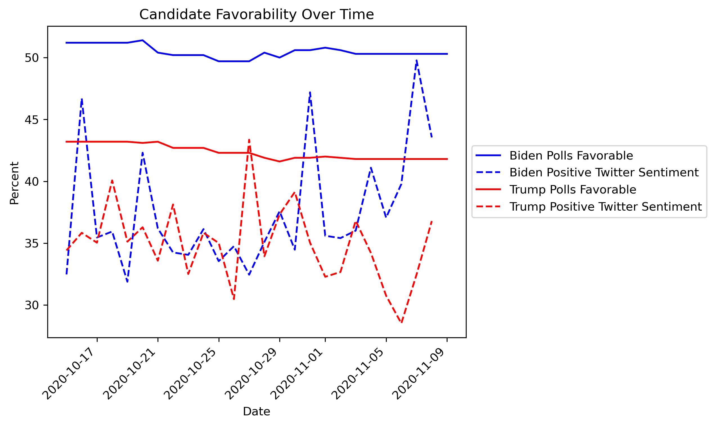
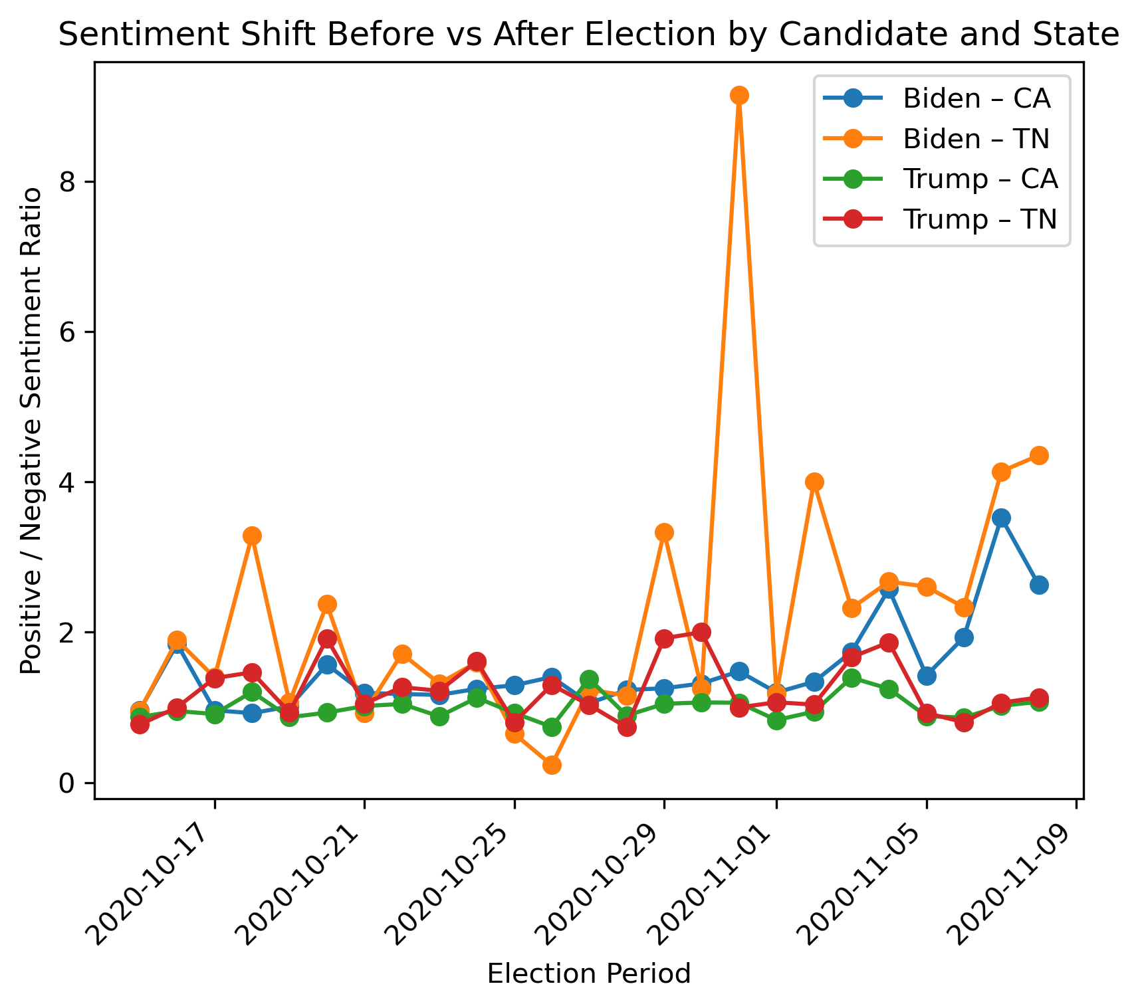
Predicting Elections: Can Social Media Provide Insight to Public Opinion?
Katherine Berwind 12338747 & Syed Irtaza Ali Shah 12453661
Introduction
Methods
Political polling has limited reach, usually reaching an older demographic, and they are notoriously unreliable compared to actual voting habits.
Social media is full of political opinions that can be mined to predict election outcomes.
Does social media reflect polled public opinion?
Are the opinion differences between candidates consistent?
Does this hold geographically as compared to actual voting?
Dataset: Historic tweets about the 2020 US Presidential election aggregated on Kaggle
VADER Sentiment Analysis: (Valence Aware Dictionary and sEntiment Reasoner) Designed for informal and short text. Ideal for tweets
2-way ANOVA comparing opinion of candidates between measurement methods
2-way ANOVA comparing Twitter sentiment of candidates between California (CA) & Tennessee (TN)
Results
Significant differences found between Twitter sentiment analysis and conventional polling when grouped by candidate and measure
Differences in candidates similar across both methods of measurement
Post-hoc analysis shows the candidate has an effect on the opinions in Twitter sentiment. Benefit from separate analysis?
ANOVA Score by Candidate & Measurement Method
 | Sum Sq | df | F | p
Candidate | 708.36 | 1 | 81.67 | 0.00
Measure | 2573.44 | 1 | 296.71 | 0.00
Interaction | 195.58 | 1 | 22.55 | 0.00
Residual | 832.63 | 96 | - | -
ANOVA Twitter Sentiment by Candidate & State
Significant differences found in sentiment between candidate and state of the poster
Raw Twitter sentiment data contradicts actual election results (Biden won CA by the widest margin; Trump won TN by the widest margin)
Post-hoc shows larger magnitude of difference in sentiment between candidates in CA as opposed to TN.
 | Sum Sq | df | F | p
Candidate | 176.54 | 1 | 817.29 | 0.00
State | 2.95 | 1 | 13.67 | 0.00
Interaction | 1.34 | 1 | 6.20 | 0.01
Residual | 13986.74 | 64750.00 | - | -
Discussion
References
Twitter sentiment and polling data do not mirror each other
Twitter sentiment by state does not hold to actual election outcome
The variability of Twitter sentiment makes it unreliable for predicting election outcomes. Polling is the more reliable choice despite limits
Actual use of twitter sentiment data requires a more in-depth methodology likely involving polarization analysis.
Crespi, Irving. Pre-election polling: Sources of accuracy and error. Russell Sage Foundation, 1988.
Federal Election Commission. (2022). FEDERAL ELECTIONS 2020 Election Results for the U.S. President, the U.S. Senate and the U.S. House of Representatives. Federal Election Commission. https://www.fec.gov/resources/cms-content/documents/federalelections2020.pdf
RealClearPolitics. (n.d.). Trump: Favorable/unfavorable. RealClearPolling. https://www.realclearpolling.com/polls/favorability/donald-trump
RealClearPolitics. (n.d.). Biden: Favorable/unfavorable. RealClearPolling. https://www.realclearpolling.com/polls/favorability/donald-trump
Hui, M. (2020, November 9). US election 2020 tweets. Kaggle. https://www.kaggle.com/datasets/manchunhui/us-election-2020-tweets
Github Repository with Methods and Scripts

